Slide 1
Advancements in Cancer Subtype Detection: Techniques and Analysis
By
Jayanth Sri Hari

Slide 2

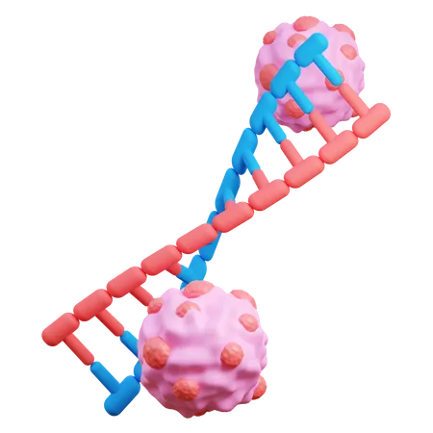
Motivation and Significance
Introduction to the importance of identifying cancer subtypes for personalized treatment
Highlight the impact of machine learning in improving subtype classification accuracy and treatment outcomes
Emphasize the potential to tailor treatment strategies to individual patients based on subtype information

Slide 3
Related Work and Techniques
Issue: previous models face challenges with overlapping clusters after clustering.
Illustration: fig 1 showcasing overlapping clusters, leading to classification ambiguity.
Contributing factors: inadequate feature selection, preprocessing, and clustering algorithms contribute to overlapping clusters.
Proposed solutions: introduce novel approaches to mitigate overlapping clusters, focusing on enhanced feature selection, preprocessing, and clustering techniques.
Expected benefits: overcoming overlapping clusters improves accuracy, reliability, and interpretability of subtype classification results.
Implementation: outline the implementation strategy for integrating proposed solutions, emphasizing rigorous validation and testing.

Slide 4
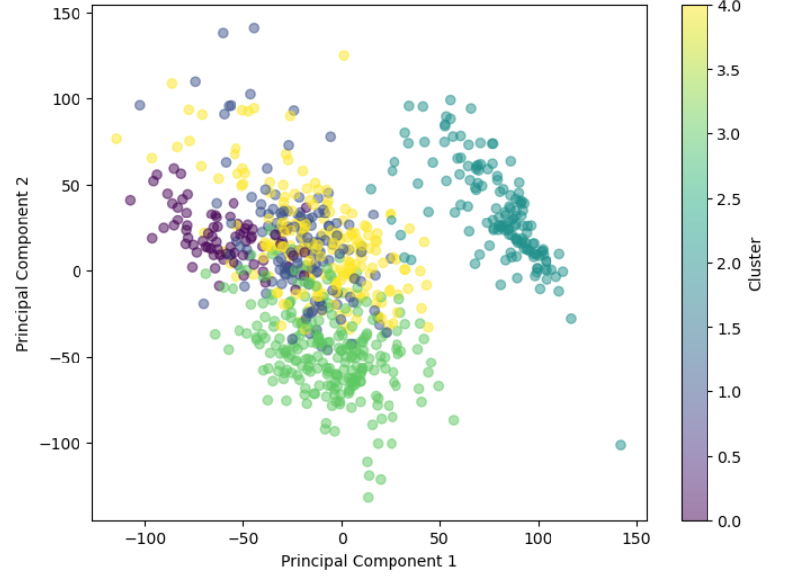
Fig 1 Overlapped clusters

Slide 5
Dataset
Cancer Samples
BRCA
KIRC
LUAD
PRAD
COAD
Dataset description:
Utilizes gene expression data from the TCGA PAN cancer project.
Aims to identify informative genes for accurate cancer type prediction.
Includes gene expression data of 800 patients across five cancer types: breast, lung, kidney, colon, and prostate.
Data Files:
data.csv: Contains gene expression data with 20532 columns.
labels.csv: Includes corresponding labels for each patient, with one column.

Slide 6
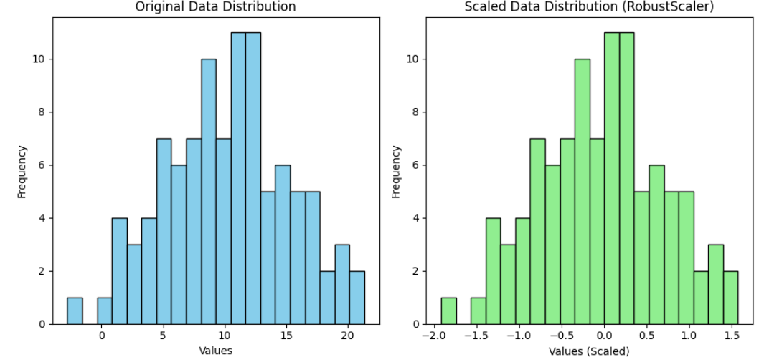
Techniques and Implementation
Robust Scaler:
Preprocessing technique used to scale features robustly against outliers.

Slide 7
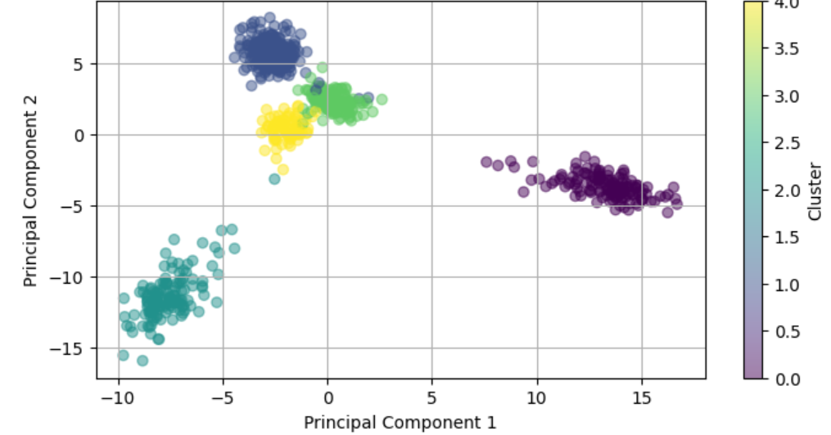
Techniques and Implementation
Spectral Clustering:
Unsupervised clustering algorithm based on spectral graph theory.

Slide 8
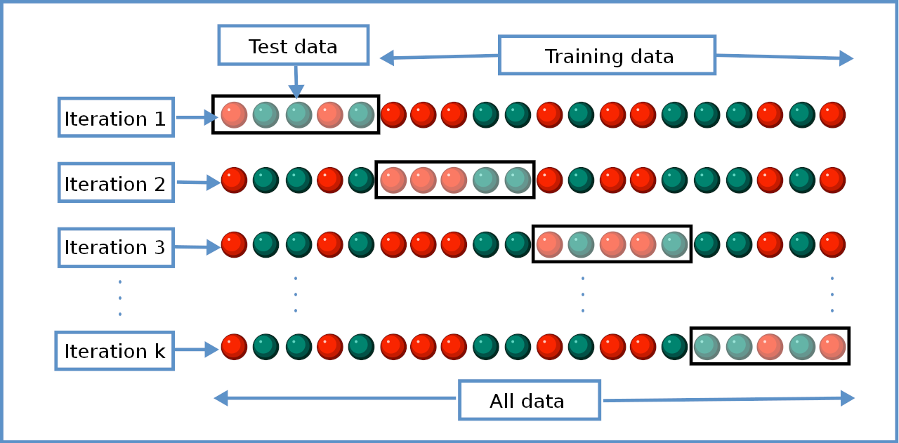
Techniques and Implementation
K-Fold Cross-Validation:
Cross-validation technique used to assess model performance by splitting the dataset into k folds.

Slide 9
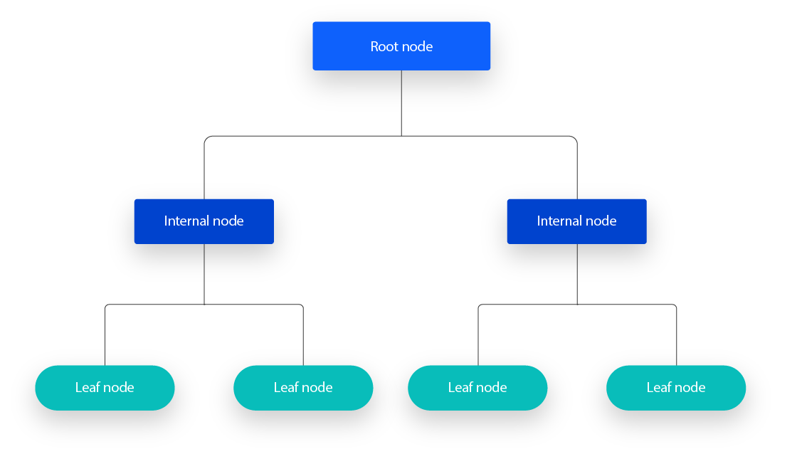
Techniques and Implementation
Decision Tree Classifier:
Supervised learning algorithm used for classification tasks based on decision tree structures.

Slide 10
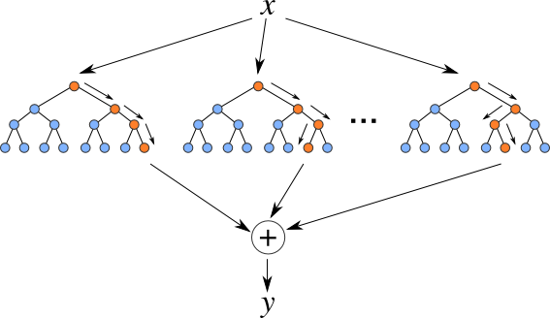
Techniques and Implementation
Random Forest Classifier:
Ensemble learning method that constructs multiple decision trees and aggregates their predictions.

Slide 11
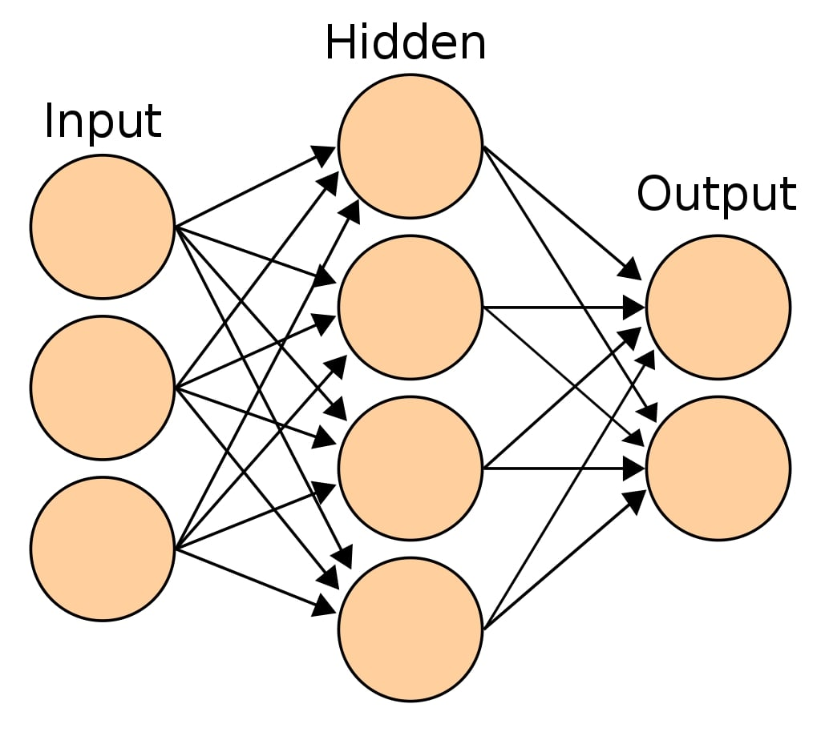
Techniques and Implementation
MLP Classifier:
Multilayer perceptron (MLP) neural network model used for classification tasks.

Slide 12

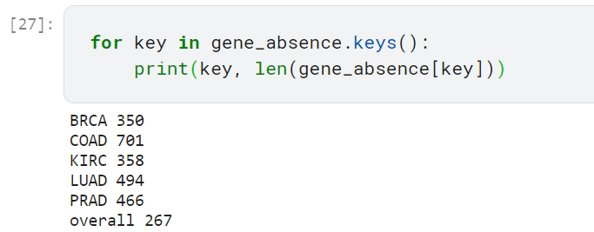
Techniques and Implementation
Gene Selection:
Removal of common genes across all samples to enhance subtype segregation.

Slide 13
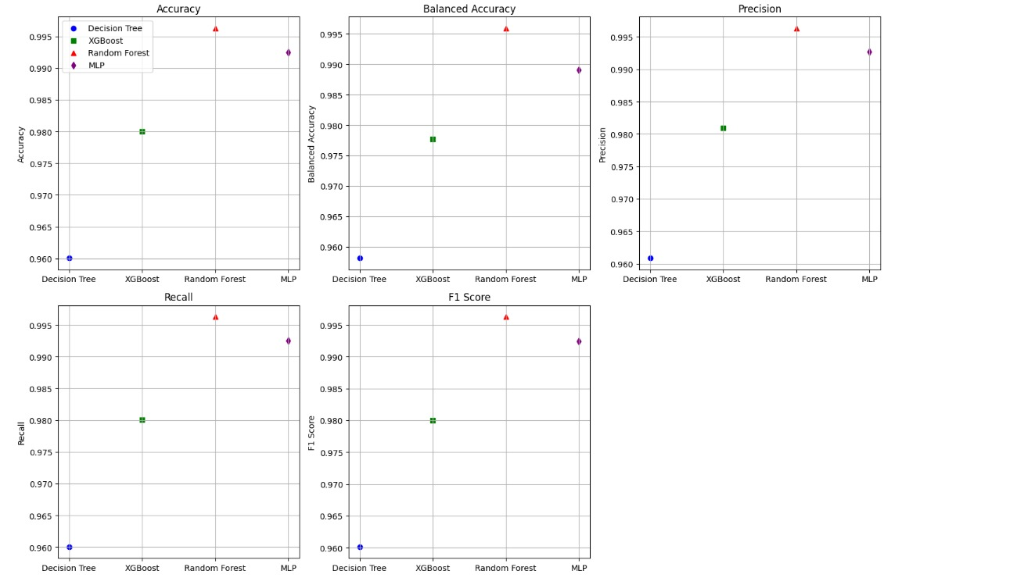
evaluation and analysis
Decision Tree:
Average Accuracy: 98.13%
Average Balanced Accuracy: 98.02%
Average Precision: 98.23%
Average Recall: 98.13%
Average F1 Score: 98.13%
Random Forest:
Average Accuracy: 99.75%
Average Balanced Accuracy: 99.72%
Average Precision: 99.75%
Average Recall: 99.75%
Average F1 Score: 99.75%
MLP Classifier:
Average Accuracy: 99.38%
Average Balanced Accuracy: 99.15%
Average Precision: 99.39%
Average Recall: 99.38%
Average F1 Score: 99.38%
These metrics demonstrate the performance of each classifier, indicating that Random Forest achieves the highest accuracy and F1 score among the three classifiers.

Slide 14
conclusion and future work
Conclusion:
The study demonstrates the effectiveness of machine learning algorithms in cancer subtype detection.
Random forest exhibited the highest accuracy and f1 score among the classifiers evaluated.
Utilizing robust scaler for data normalization improved model robustness, particularly in the presence of outliers.
Future work:
Explore ensemble methods to further enhance classification performance.
Investigate deep learning approaches for feature extraction and classification.
Incorporate multi-omics data integration for a more comprehensive analysis.
Extend the study to include additional cancer types and larger datasets for improved generalization.

